Slide 1
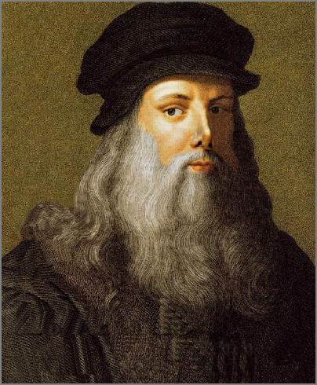
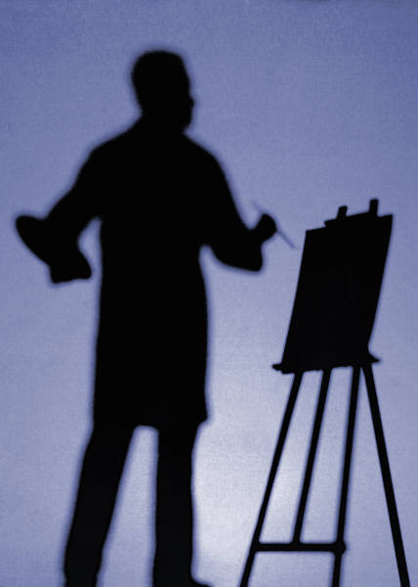
Leonardo Da Vinci as an artist

Slide 2
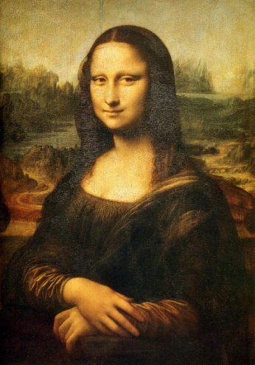
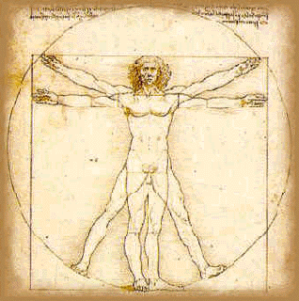
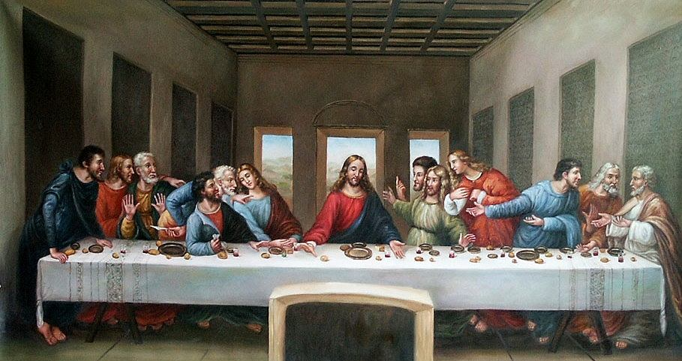
True fact about Leonardo’s drawings
Leonardo Da Vinci drew the Mona Lisa .
Leonardo also drew the last supper.
He tried to make a bronze horse.
He did not finish all his drawing .
He also drew the Vitruvian man

Slide 3
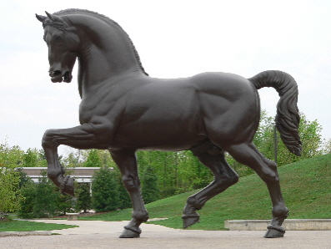
Leonardo made a horse out of bronze
The king ordered Leonardo to make a horse out of bronze . So that know that people know that the king owns that place and so people think he is rich. When he was done with the bronze horse the French came and destroy it.

Slide 4
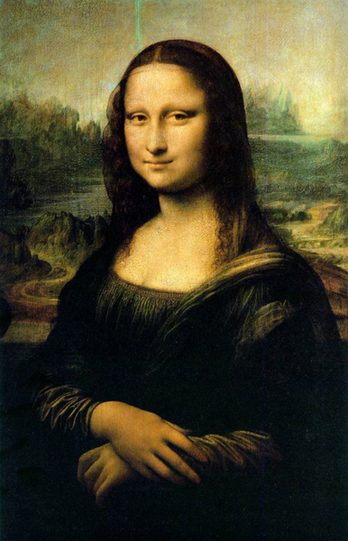
Mona Lisa
Leonardo Da Vinci painted the Mona Lisa . The Mona Lisa is a famous painting of Leonardo. Leonardo started painting the Mona Lisa in 1503 and finished in 1507 that took a long time.

Slide 5
Thank you for watching hope you enjoyed it!!

