Slide 1
Leonardo the artist

Slide 2
Leonardo is a famous painter
Leonardo’s rival is Michelangelo
the Mona Lisa is one of Leonardo's most famous painting
Leonardo was known for his paintings

Slide 3
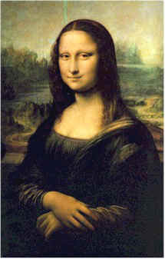
Leonardo’s Paintings
Leonardo made many famous paintings
The Mona Lisa is one of them

