Slide 1
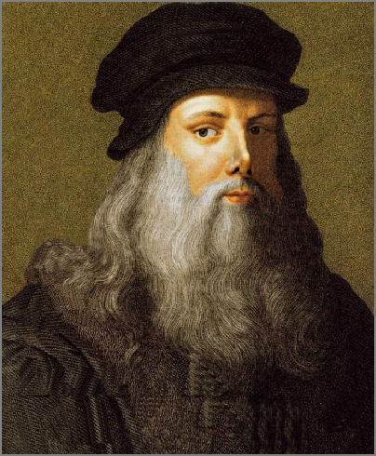
Leonard Da Vinci
by: Joe

Slide 2
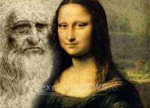
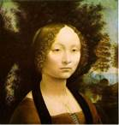
Da Vinci’ Art
Painter, sculptor, architect, designer, theorist, engineer and scientist, Leonardo da Vinci created some of the most famous images in European art. One of his most famous painting is the Mona Lisa(which is shown above).

Slide 3
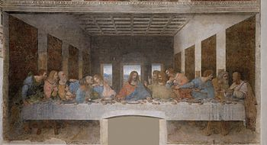
Born in April 15,1452
the last supper the most reproduced religious painting of all time, with their fame approached only by Michelangelo's.
Last supper

Slide 4
Facts
Facts about da Vinci.
Da Vinci was born in 1452.
he liked to paint when he was young.
The Mona Lisa was one of the most famous paintings.
Born in Italy close to Florence.

Slide 5
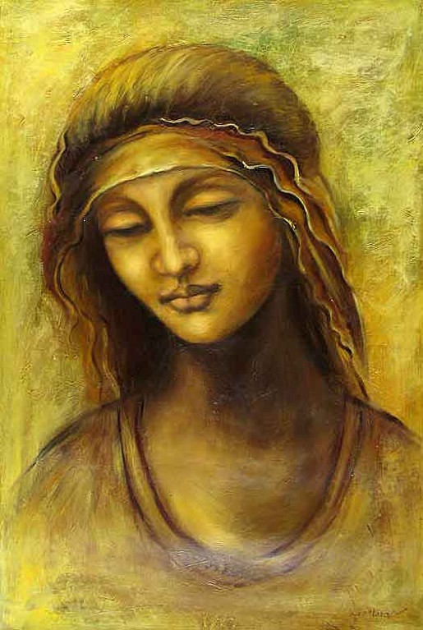
Da Vinci's live
Leonardo Da Vinci's numerous skills have earned him the title of renaissance master. Da Vinci's fascination with science and his in-depth study of human anatomy aided him in mastering the realist art form. While Leonardo's counterparts were known to create static art.
He died 1519 may 2

