Slide 1
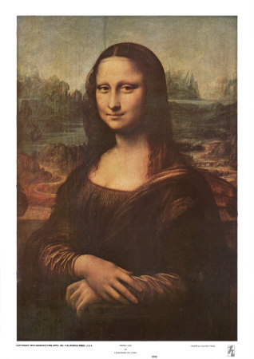
Da Vinci’s art
DA Vinci drew the Mona Lisa
By. JOSE

Slide 2
MONA LISA
DA VINCI SATARTED TO PAINT THE MONA LISA WHEN HE WA 51 YEARS OLD AND FINISHED IT 55YEARS OLD.

Slide 3
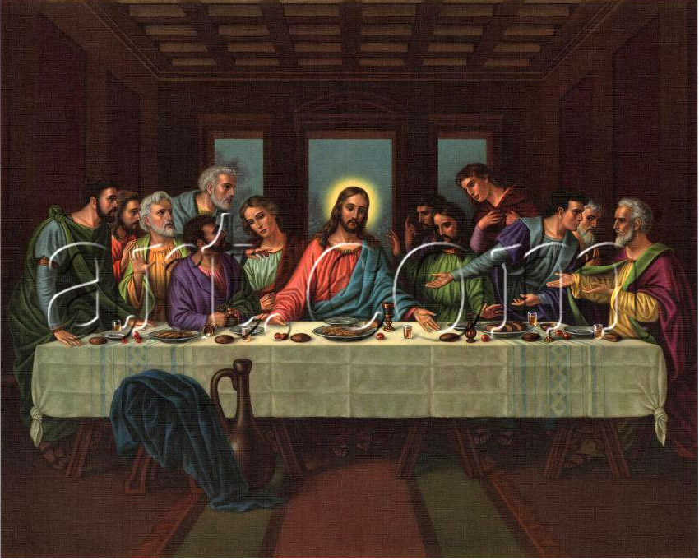
THE LAST SUPPER
HE STARTED THE LAST SUPPER WHEN HE was 43 years old and finished at 46

Slide 4
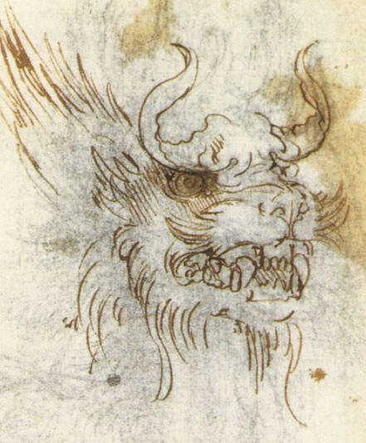
Fierce dragon

Slide 5
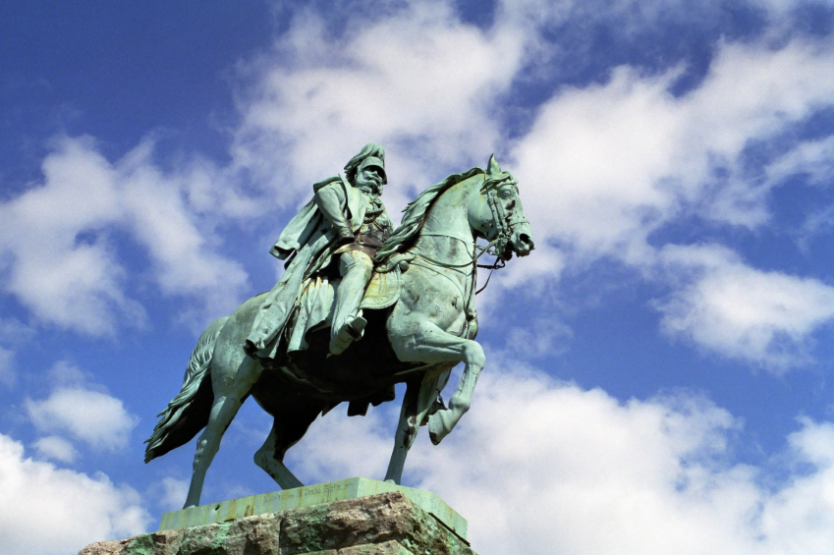
He created the bronze horse
The French came and destroyed it

