Slide 1
Da Vinci
artist

Slide 2
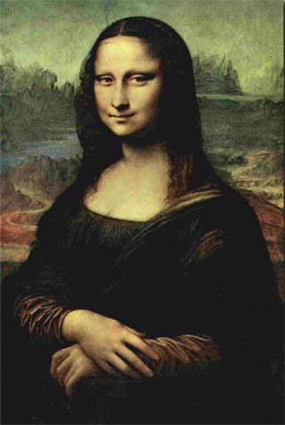
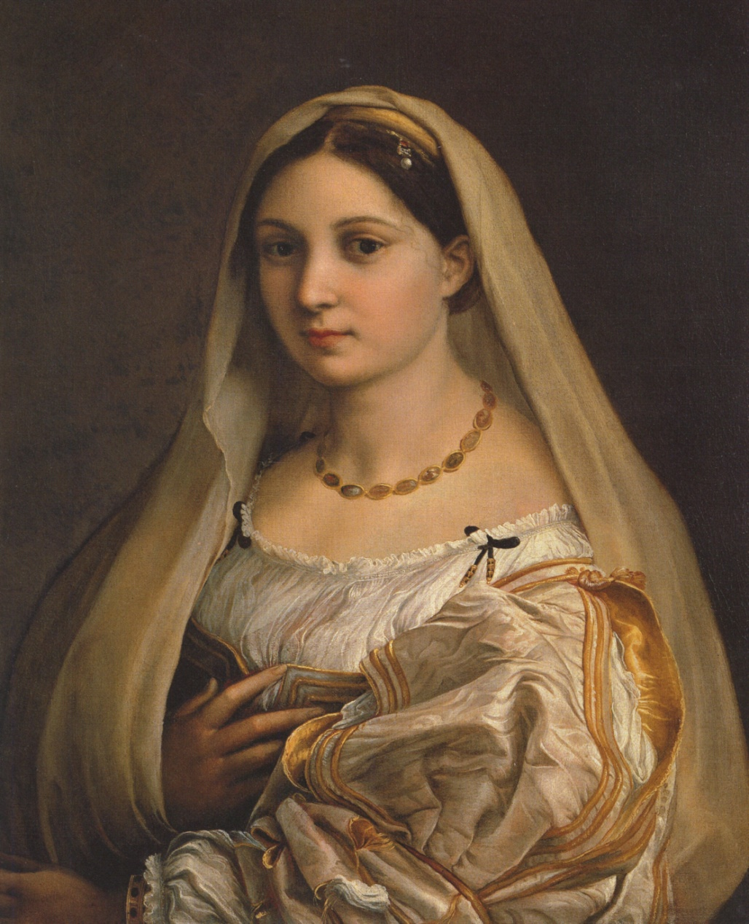
Leonardo panted the Mona Lisa.
Leonardo also painted this picture.

Slide 3
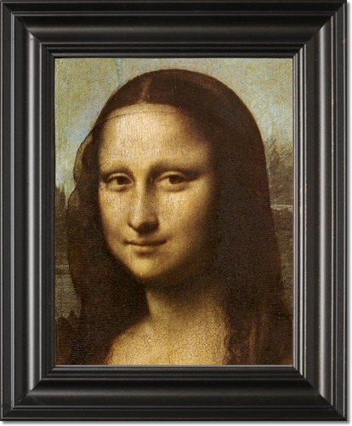
facts
Leonardo was a painter and a philosopher.

