Slide 1
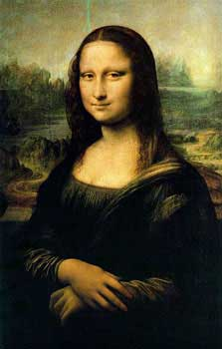
Leonardo Da Vinci as an artist by Kylee Peterson

Slide 2
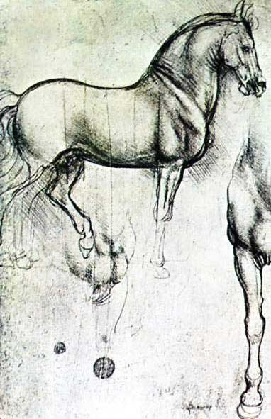
Drawings Leonardo Da Vinci drew
Leonardo Da Vinci was an artist he drew many painting, he drew the Mona Lisa. He drew the Mona Lisa, the Burlington house cartoon, and the virgin of the rocks from panels from the s. Francesco altarpiece Milan, he also drew the virgin and child and an angel in green with a vielle from panels from the s. Francesco altarpiece, Milan.

Slide 3
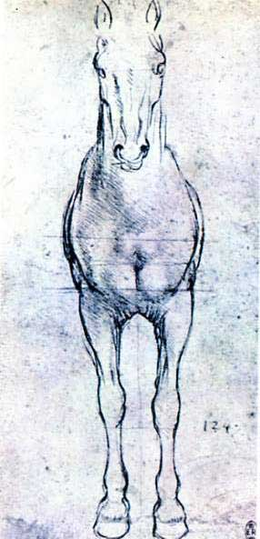
What happened to Leonardo Da Vinci's bronze horse
He tried to sculpt a horse out of bronze for the duke but before it was finished people destroyed it. He was going to send
A letter to the duke of what he
Could make for him but he
Ended but not sending it to the
Duke. The bronze is made out
Of tin and copper.

Slide 4
What happened in Leonardo Da Vinci’s life
When Leonardo was a kid his dad took him to study art. Leonardo Da Vinci didn’t get to finish his horse he died before
He finished it. But Charles
Dent tried to finish the bronze
Horse. On September tenth
1999 Nina Akamu finished the
Bronze horse finally.

Slide 5
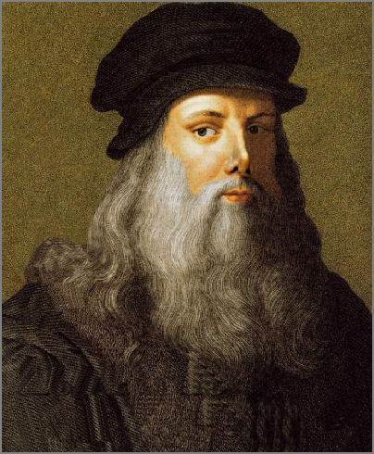
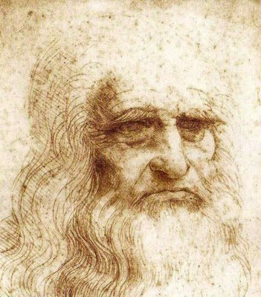
Other jobs Leonardo Da Vinci did
all the jobs he did was he was a philosopher, inventor, artist, and a sculpt maker. He could also draw horses pretty good.

