Slide 1
Leonardo Da Vinci artist
by Karmen Hamilton

Slide 2
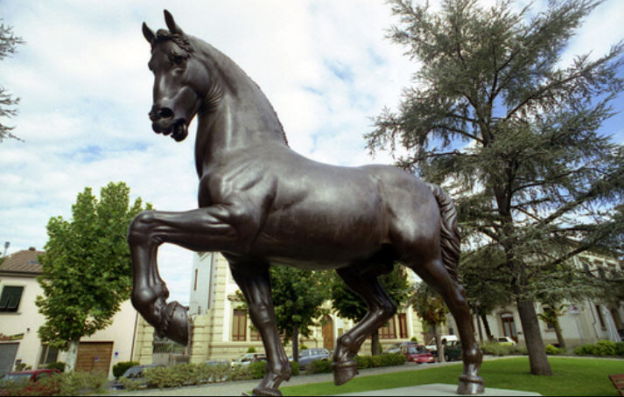
Da Vinci made his house for the Duke .

Slide 3
Robot
Da Vinci designed a robot that NASA is using to create the robot in the picture.

Slide 4
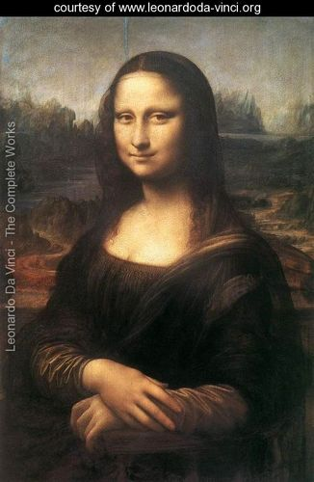
Mona Lisa
Leonardo Da Vinci designed this picture

Slide 5
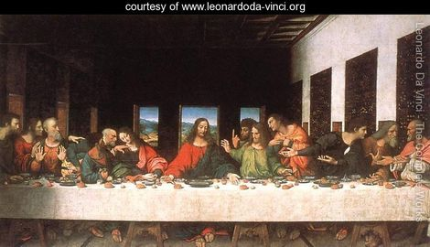
Da Vinci designed this painting to show how important it was to have the last supper.

