Slide 1
Leonardo da Vinci
Artist

Slide 2
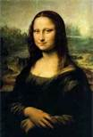
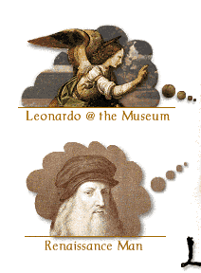
Leonardo painted the Mona Lisa

Slide 3
HE PAINTED MONA LISA
HE PAINTED A LOT MORE
It was hard work
He didn’t finish Mona Lisa
Mona Lisa was pregnant when she was getting painted

Slide 4
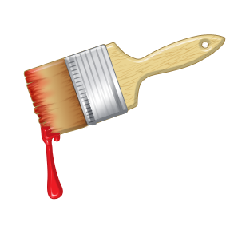
he put lot of his sketches in his notebook so he can draw them better
He was a good artist

Slide 5
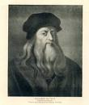
Born 4-15-1452 died 5-2-1519

