Slide 1
Leonardo Da Vinci
By Audrey Martin

Slide 2
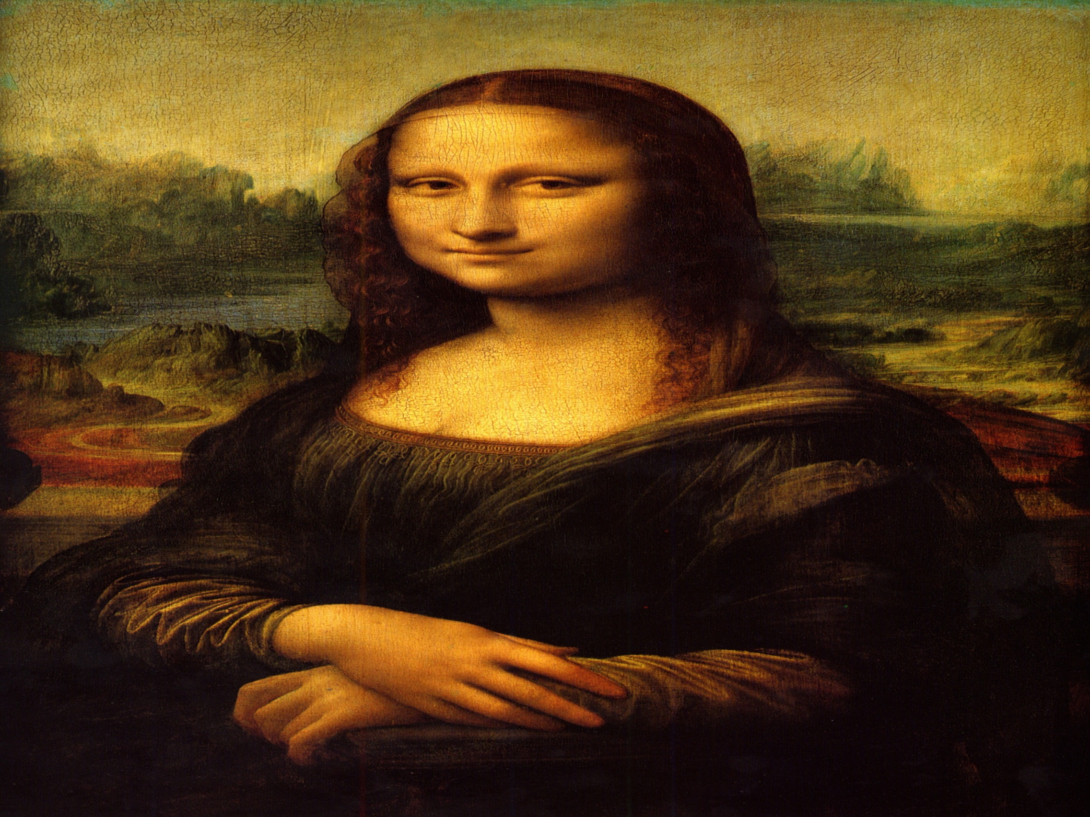
Leonardo Da Vinci is a famous artist. He painted the Mona Lisa and a lot of other paintings. He painted The Virgin and Child, The Virgin of Rocks and many many more paintings.

Slide 3
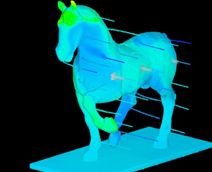
  Leonardo Da Vinci started sculpting a horse made out of bronze. He died before he got to finish the bronze horse. So Charles Dent tried to finish but he also died before he could finish. Finally on September 10,1999 Nina Akamu finished the bonze horse.

Slide 4


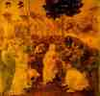
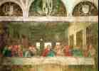
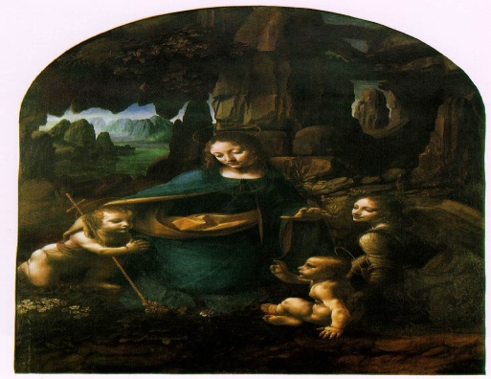

Ginevra De Benci
Madonna Litta
The adoration of the magi
Lady with an Ermine
The Virgin of The Rocks
The Last Supper

Slide 5
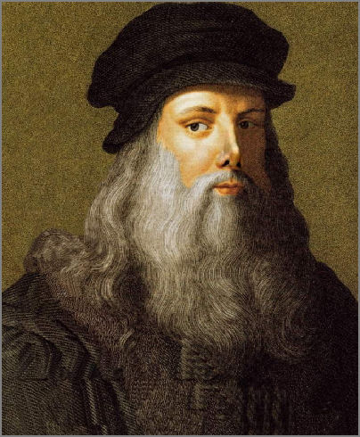
Leonardo Da Vinci's mothers and fathers names were caterina and his fathers name was ser Piero Da Vinci . Leonardo was born on April 15 1452 and he died on may 2 1519. Not a lot of people know how he died. I think it was old age.

