Slide 1
Da vinci the inventor
By Xander.

Slide 2
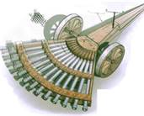
One of Da Vinci's inventions was an eight gun cannon.

Slide 3
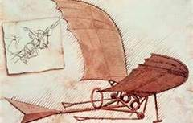
He tried to fly but he couldn't

Slide 4
He also made a armored tank

